Slide 1
60
Critical Issues in Fake Supply E-Invoicing and E-Way Bill
Session XI
5th Workshop on Goods and Services Tax
All India Chartered Accountants Society
5th August 2023
Restricted circulation

Slide 2
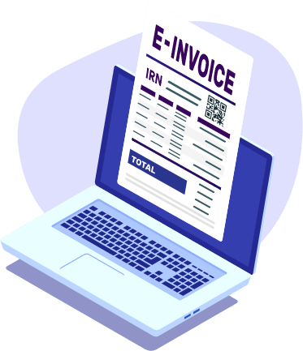
E-INVOICING
Implementing e-invoicing in GST
The GST Council has approved the introduction of e-invoicing in a phased manner for reporting of business–to–business (B2B) invoices to the GST System. the CBIC has announced the rollout of the 6th phase of e-invoicing. As of August 1st, 2023, businesses with an annual turnover of ₹5 crore or more since 2017-18 will be required to generate e-invoices.
This is introduced based on turnover criteria as detailed below:
TAX REVENUE
INFRASTRUCTURE
CAPEX
GST
Annual turnover | New date of mandatory implementation of e-invoice
Exceeding 500 crore | 1st October 2020
Exceeding 100 crore | 1st January 2021
Exceeding 50 crore | 1st April 2021
Exceeding 20 crore | 1st April 2022
Exceeding 10 crore | 1st October 2022
Exceeding 5 crore | 1st August 2023
EXPORTS
INDIA HIGHLIGHTS

Slide 3
E-INVOICING
CRITICAL MATTERS - E-INVOICING SYSTEM
Complications while Integrating ERP Systems
Though Most ERPs are Customizable and Frequent Changes in Government’s API Integration Framework, Invoice Format and other requirements bring cost to companies.
Homegrown Accounting Software's which do not have scalable server or API interface sometimes face compatibility issues and increase manual work
Cancellation and Amendment Policies of e-invoicing
E-Invoicing allow
Invoice Creation (IRN Generation) for up to 7 days including the date of Invoice
Cancellation only for 24 hours once raised
E-Invoicing do not allow amendment in Quantity or Value
Hence, in case of error, one needs to issue a credit note / debit note against the previous invoice only.
ITC is not available in absence of E-invoicing if it was applicable
It is not very feasible for a buyer to know if the supplier’s turnover is above the threshold at any time from 2017-18 onwards.
Accordingly, every Buyer has applied their own diligence methods for this, some of the examples are
Obtaining a Declaration from each suppler on applicability of e-invoice to them.
Obtaining a CA Certificate to this effect from each supplier
Obtaining a Screenshot of GST Portal where Aggregate turnover is given.
03

Slide 4
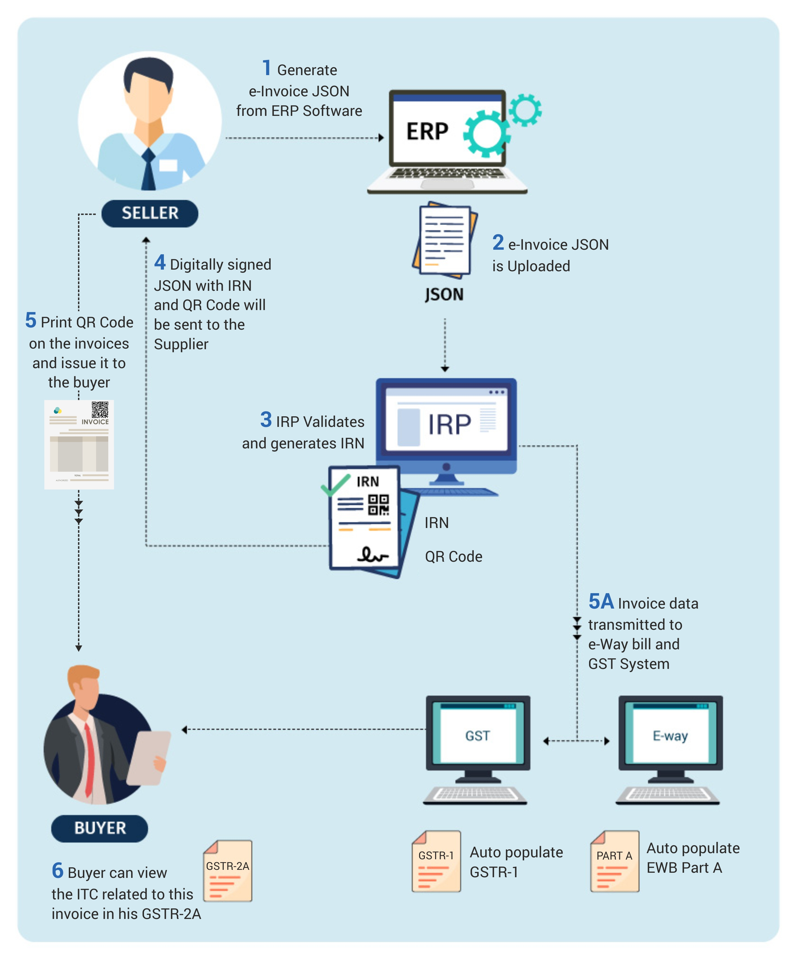
E-INVOICING
CRITICAL MATTERS - E-INVOICING SYSTEM
If generated an e-Invoice by mistake and it is not cancelled within 24 hours?
One needs to issue a credit note against the previous invoice only.
If one has crossed the notified Turnover in the current year, does he need to generate E invoices?
No, e-Invoice is applicable only if the notified turnover is crossed in any of the previous years.
Once in E-Invoicing cannot go to normal unless the turnover slips below the threshold fixed to obtain GST Registration (40 Lacs / 20 Lacs as the case may be) and one surrender the GST Registration.
Penalties in respect of E-Invoicing
Non-issuance of E-Invoice
Higher of Rs.10,000 or actual Tax chargeable on the Invoice
Incorrect or erroneous E-Invoice
Rs. 25,000 per such Instance
03

Slide 5
E-Way Bill – Key Judgements
Travelling without E-Way Bill attracts penalty irrespective of Intent of Parties
Travelling without a proper e-way bill attracts penalty and intention of parties committing such violation was wholly irrelevant; provision to revalidate e-way bill is required to be strictly complied with.
Pushpa Devi Jain vs. Assistant Commissioner of Revenue Bureau of Investigation
[2023] 149 taxmann.com 206 (Calcutta) (03-03-2023)
Penalty is leviable if E-Way Bill is not issued post expiry for transport of goods irrespective of circumstances
Assessee was required to generate fresh e-way bill when goods are transported in different vehicle due to breakdown of original vehicle;
Authorities were not required to ascertain reasons for transporting goods in different vehicle
Asian Switchgear (P.) Ltd. vs. State Tax Officer
[2023] 149 taxmann.com 120 (Calcutta) (03-03-2023)
Penalty levied due to clerical errors / genuine mistake in E-Way Bill is not justified, hence quashed
In the case of Robbins Tunnelling and Trenchless Technology (India) (P.) Ltd., the issue at hand was the detention of goods in transit due to an erroneous shipping address in the e-way bill.
The assessee had imported goods from the USA, and their clearing agent mistakenly entered their own name as the consignee in the e-way bill instead of the recipient's name and address.
As a result, the competent authority detained the goods and imposed tax and penalties. The appellate authority upheld the decision, considering the mistake as more than a clerical error. However, the High Court quashed the tax and penalty levied, stating that the appellate authority was unjustified in its decision.
The Supreme Court dismissed the special leave petition filed against the HC's judgment and order.
State of Madhya Pradesh vs. Robbins Tunnelling and Trenchless Technology (India) (P.) Ltd
[2021] 133 taxmann.com 165 (SC) (17-09-2021)
03

Slide 6
FAKE SUPPLY AND INVOICING
FAKE SUPPLY & INVOICING
Fake invoices are not defined under any law. It is interpreted over the years with trade practices and legal precedents under laws where violations from legal provisions are triggered.
What are fake invoices -
where the registered persons are found to be involved in
issuing tax invoice, without actual supply of goods or services or both
in order to enable the recipients of such invoices to avail and utilize input tax credit fraudulently.
Intent behind Fake Invoicing-
Hiding Identity of real supplier
Avoid tax payouts on Supply to defraud Government
Booking of fake purchases for getting undue tax benefits
Circular Trading or Chain Transactions
Conversion of excess ITC into cash
Routing of invoices through a series of shell companies/dummy companies
Shifting of ITC from exempted supplies to taxable supplies
Encashment of ITC by way of IGST refund or unutilised ITC refund.
Undue benefit in Income Tax (Avoiding payment of Income-tax by reducing net profit)
Cash generation/ diversion of company funds
FAKE SUPPLY

Slide 7
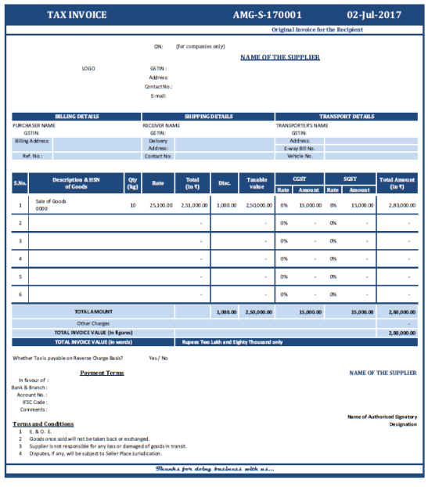
FAKE SUPPLY AND INVOICING
SALIENT FEATURES & IDENTIFICATION
CRITICAL FAQS
ITC involved in the fraud cases usually reaches a large sum in a short timeframe
E-way bills have been generated without the corresponding filling of returns
Frauds usually involve large number of GSTIN entities spread over States
Dummy firms are created/floated to commit the fraud
Connivance with transporters to get bogus bilty / consignment note to show movement of goods on paper.
Creating fake e-Way bills with fake/wrong vehicle registration details without the supply of any goods.
GSTR-1 is filed but GSTR3B is not filed.
How to find a fake GST invoice-
Ensure if all the mandatory details are filled on the invoice
Check the GST registration number
GST rate charged by a supplier
HSN / SAC used by Supplier
Compare with past invoices

Slide 8
FAKE SUPPLY AND INVOICING
MEASURES TAKEN BY GOVERNMENT TO CURB GST FRAUD
CRITICAL FAQS
Following steps have been taken by Indian Government to abstain taxpayers from committing GST Fraud:
Implementing a robust e-invoicing system to ensure authenticity and traceability of invoices.
Introducing measures to detect and prevent fake invoices and tax evasion, such as the use of data analytics and intelligence-driven investigations.
Increasing awareness and education among businesses and taxpayers about the importance of compliance and the consequences of engaging in fraudulent practices.
Enhancing the technology and infrastructure of the GSTN (Goods and Services Tax Network) to handle the vast data generated by e-invoicing and e-way bills effectively.
Integration & Cross verification between NHAI, State Toll Gates, Invoice and E-Way Bill Records
Compare import data from Custom’s database with Sales as per GSTR 1 and GSTR 3B
Appearance of the invoices in GSTR-2B
Blocking of credit in the hands of receiver of invoice Rule 86A
Geocoding of Address of Principal Place of Business
Introduction of Form DRC-01B (Difference Appearing in R1 – R3B)
Introduction of E-Invoice Verifier App

Slide 9
FAKE SUPPLY AND INVOICING
SAFEGUARDS AND EVIDENCES TO PROVE GENUINESS OF TRANSACTIONS
Under GST regime, it is essential for businesses to maintain proper records and evidence to prove the genuineness of their transactions. This is crucial to ensure compliance and avoid any potential disputes with the tax authorities.
CRITICAL FAQS
Here are some safeguards and evidences that businesses can utilize to prove the genuineness of transactions under GST:
Possession of Tax Invoice as referred in Sec 31 r/w Rule 46
Proof of Delivery/Receipt of Goods or Services
E-way bills required for the movement of goods, warehouse receipts
Maintaining bank statements, payment vouchers, or any other payment-related evidence
Accurate stock and inventory records
Valid contracts or agreements in place for supply of goods or services
Correspondence and Communication: Preserving emails, letters, or any other written communication
Digitizing and storing all relevant documents electronically can help in easy retrieval and access

Slide 10
FAKE SUPPLY AND INVOICING
IMPORTANT REPORTS AVAILABLE TO TAX AUTHORITIES
Report of non-filers of GSTR 1 & 3B and list of all persons who purchased from non-filers including exporters claiming refund .
Reports of non-fillers of GSTR 3B but who have filed GSTR 1. Other linked report is all purchasers from these non-filers ​
Mirror imaging - Compare ITC availed as per GSTR 2B/2A of recipient and status of GSTR 3B of supplier ​.
Report of GSTR- 1 – 3B difference .
Search tool – one mobile/mail – how many registration ​
Fast tag & RFID reports for movement of vehicle ​
Cancellation of E-way bill by tax-payer/transporter with time bands ​
Report of mismatch of HSN wise purchase and Sale ​
E-way bill and GSTR 1 mismatch ​
High value transaction by new registrants.​
Report of suspected bogus Export refund cases - Coordinated Study by investigation teams of GST, Customs, and Data Analysis wing to find out bogus exports.​
Tax-payer paying substantial tax through utilization of ITC.​
Valuation – Same HSN – per unit valuation by different person.​
Tax-payers migrated to and from a jurisdiction.​
Data sharing with CBDT – PAN and TDS deduction.
CRITICAL FAQS

Slide 11
FAKE SUPPLY AND INVOICING
PENALTY CONSEQUNECES FOR FAKE INVOICING UNDER GST
CRITICAL FAQS
Penal Consequences
Issuer of Fake Invoices
Receiver of Fake Invoice
Any Other Person facilitating such supply

Slide 12
FAKE SUPPLY AND INVOICING
ISSUER OF FAKE INVOICE
CRITICAL FAQS
No demand prosecution under section 74. Since there is only issuance of the invoice, without actual supply of goods or services or both, demand proceedings cannot be initiated.
Imposition of penalty under section 122(1)(ii) “issues any invoice or bill without supply of goods or services or both in violation of the provisions of this Act”
Maximum amount of penalty will be higher of the following amounts –
INR 10,000; or
Amount of tax evaded (ITC Passed on)

Slide 13
FAKE SUPPLY AND INVOICING
Receiver of fake invoice
CRITICAL FAQS
Demand proceedings –
Demand proceedings can be initiated as and when input tax credit has been availed by the receiver based on the fake invoice in GST.
Notably, on account of contravention of provisions of section 16(2)(b) of the Central Goods and Services Tax Act, 2017, demand proceedings can be initiated on the receiver under section 74 of the Central Goods and Services Tax Act, 2017.
Imposition of penalty –
As per section 122(1)(ii) “where any taxable person takes or utilises input tax credit without actual receipt of goods or services or both either fully or partially, in contravention of the provisions of this Act or the rules made thereunder” Maximum amount of penalty will be higher of the following amounts –
INR 10,000; or
Amount of tax evaded (Credit availed)

Slide 14
FAKE SUPPLY AND INVOICING
Any other person facilitating such fake invoice transactions
CRITICAL FAQS
Imposition of penalty –
Any person who retains the benefit of a transaction will be liable to pay a penalty under section 122(1A) of the Central Goods and Services Tax Act, 2017.
Here, a penalty amount equivalent to 100% of the tax evaded is imposable.

Slide 15
FAKE SUPPLY AND INVOICING
Punishment for certain offences – Section 132 CGST
CRITICAL FAQS
Whoever commits or causes to commit and retain the benefits arising out of, any of the following offences, namely:
(b) Issues any invoice or bill without supply of goods or services or both in violation of the provisions of this Act, or the rules made thereunder leading to wrongful availment or utilisation of input tax credit or refund of tax.
(c) avails input tax credit using the invoice or bill referred to in clause (b) or fraudulently avails input tax credit without any invoice or bill.
shall be punishable for-
Amount of tax evaded | Punishment
1cr to 2cr | Imprisonment up to 1 year with fine
2cr to 5cr | Imprisonment up to 3 years with fine
>5Cr | Imprisonment up to 5 years with fine

Slide 16
FAKE SUPPLY AND INVOICING
Relevant Judgements
Recipient’s ITC cannot be denied in case of Non-existent Supplier or Retrospective GST Registration Cancellation
Gargo Traders, has claimed ITC against the purchases made from a fake and non-existent supplier, and their bank accounts were based on fake documents. The authorities claimed that the petitioner had not applied due diligence in verifying the genuineness and identity of the supplier while making the purchase.
the petitioner defends itself by stating that it had all the valid documents, i.e., invoice, e-way bill, debit/credit notes, and bank statements, to support the genuineness of the transactions
The court ruled in favor of the petitioner, stating that at the time of the transaction, the supplier's name was already available in government records as a registered taxable person. The petitioner had made the payments through a bank, not in cash, and there was no evidence of collusion between the petitioner and the supplier.
M/s. Gargo Traders v. The Joint Commissioner, Commercial Taxes
[(2023) 151 taxmann.com 270 (Calcutta)(12-06-2023)]
Burden of Proving Genuineness of Input Tax Credit is on the recipient.
Assessing Officer as well as first appellate authority denied ITC under KVAT as genuineness of purchase transaction was doubted on ground that selling dealers were either de-registered or had filed nil returns or had denied sale
In appeal, Tribunal allowed ITC by holding that payment of purchased goods was made under account payee cheques against invoice and that purchasing dealer should not suffer due to default of seller - High Court under impugned revision order, affirmed Tribunal order
Held that burden of proof was on purchasing assessee to establish genuineness of transaction against which ITC had been claimed - Merely claiming to be a bona fide purchaser was not enough and sufficient to avail ITC
State of Karnataka Vs M/S Ecom Coffee Trading Private Limited
[(2023) 148 taxmann.com 352 (SC)]
CRITICAL FAQS

Slide 17
FAKE SUPPLY AND INVOICING
Relevant Judgements
CRITICAL FAQS
Refund of unutilized ITC could not be denied merely based on allegations of fake credit availed by the supplier
The High Court held that the refund of unutilized ITC could not be denied based on allegations of fake credit availed by the supplier unless it was established that the petitioner had not received the goods or paid for them. The court emphasized that there was no conclusive finding or cogent material to support the allegation of fake invoices. Therefore, the applications for refund could not be denied.
Balaji Exim vs. Commissioner CGST
[(2023) 149 taxmann.com 44 (Delhi) (High Court)]

Slide 18
Role of Artificial Intelligence (AI) and Big Data Analytics by Government, sharing of info by others
Role of AI and Big Data Analytics by Government – Background
The role of Artificial Intelligence (AI) and Big Data Analytics in the context of the Goods and Services Tax in India is becoming increasingly significant.
The Indian government, as well as other stakeholders, can leverage AI and Big Data Analytics to enhance compliance, improve tax administration, detect fraud, and facilitate data sharing among various entities.
As per Press Release dated 27 MAR 2023 the Government is using data analytics, big data and Artificial Intelligence/Machine Learning in tax administration to make it more effective, free of official discretion, business and taxpayers friendly. “Both direct and indirect tax departments employ data analytics, big data and Artificial Intelligence/Machine Learning in tax administration to make it more effective, free of official discretion, business and taxpayers friendly”
CRITICAL FAQS
While commemorating the GST's Sixth anniversary on the first day of July 2023, The Finance Minister highlighted benefits to MSME under GST by easing their compliance burden through measures like composition scheme, QRMP (quarterly return with monthly payment, optional annual return etc).
The centre piece of the GST-Facilitation Revolution has been technology. GST is technology-enabled and technology-driven.
On the same day, A film on “GST Leveraging Technology for Nation Building” was showcased during the event. The film explored how technology has helped to create a bridge between government and taxpayer, revolutionized GST compliances by bringing all compliances online and use of Artificial Intelligence and Machine Learning to target tax evaders.

Slide 19
Role of Artificial Intelligence (AI) and Big Data Analytics by Government, sharing of info by others
Role of AI and Big Data Analytics by Government – Background
CRITICAL FAQS
While commemorating the GST's Sixth anniversary on the first day of July 2023, The Finance Minister highlighted benefits to MSME under GST by easing their compliance burden through measures like composition scheme, QRMP (quarterly return with monthly payment, optional annual return etc).
The centre piece of the GST-Facilitation Revolution has been technology. GST is technology-enabled and technology-driven.
On the same day, A film on “GST Leveraging Technology for Nation Building” was showcased during the event. The film explored how technology has helped to create a bridge between government and taxpayer, revolutionized GST compliances by bringing all compliances online and use of Artificial Intelligence and Machine Learning to target tax evaders

Slide 20
Role of Artificial Intelligence (AI) and Big Data Analytics by Government, sharing of info by others
KEY ASPECTS OF AI and Big Data Analytics
CRITICAL FAQS
Improving Tax Administration and Compliance
Detecting Tax Evasion and Fraud
Data Sharing and Collaboration
Data-Driven Policy Making
Real-Time Monitoring
Predictive Analysis

Slide 21
Role of Artificial Intelligence (AI) and Big Data Analytics by Government, sharing of info by others
ADVANCED ANALYTICAL METHODS TO COMBAT GST FRAUDS
CRITICAL FAQS
Business Intelligence and Fraud Analytics (BIFA)
Advance Analytics in Indirect Taxation (ADVAIT)
GST Prime by NIC
E-way Analytics
Automation of Central Excise & Service Tax - GST

Slide 22
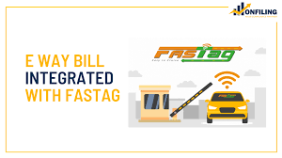
Integration & Cross verification between NHAI, State Toll Gates, Invoice and E-Way Bill Records
Integration & Cross verification between NHAI, State Toll Gates, Invoice
and E-Way Bill Records Background
CRITICAL FAQS
GST officers have been armed with real-time data of commercial vehicle movement on highways with integration of the e-way bill (EWB) system with FasTag and RFID, a move which is helping in live vigilance of such vehicles and check GST evasion.
A memorandum of understanding was signed between Indian Highways Management Company Ltd (IHMCL) and Goods and Services Tax Network (GSTN) for the integration of FASTag with the GST e-way bill system on 14th October 2019.

Slide 23
THANKS FOR
THIS OPPORTUNITY
WILL BE HAPPY
TO TAKE QUESTIONS
CA Vaibhav Jain
Partner
B.Com (Hons), FCA, ACS, LLB, DISA (ICAI), MBF (ICAI), FAFD (ICAI), CCIDT (ICAI), CCCA (ICAI), ID (MCA-IICA), Registered Valuer (SFA) (IBBI)
Mobile No:- +91-9711310004 | Email:- vaibhavjain@mehragoelco.com

